Slide 1
Prototyping
Lecture 9

Slide 2

Do you remember the concept of design thinking?

Slide 3
Design thinking framework
Empathize
Define
Ideate
Test
Prototype

Slide 4
The focus of this lecture is the prototyping and testing phase
Develop the prototype
Test its usability
Redesign and rebuild based on feedback

Slide 5
Prototyping
Build a representation of your idea
It can be a full working model
It can also be a cardboard cutout
It can even be paper, or a drawing

Slide 6
Purpose of prototype
Explore how your idea will work
Show something to your customers
See their reactions to the prototype
Testing should be done by users
There should be no input from you
Remember: the prototype is completely dispensable

Slide 7

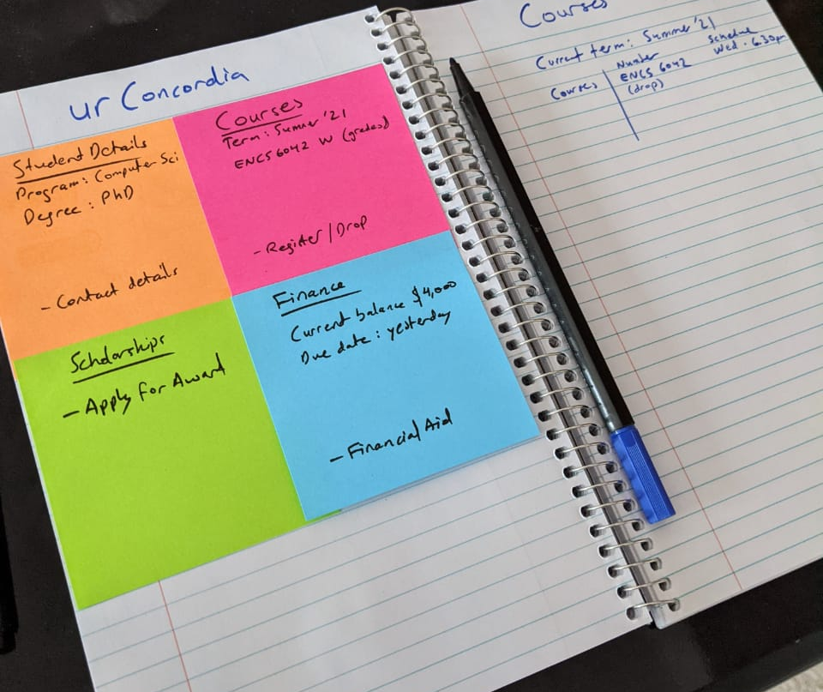
Prototype example
Notes:
This is intended as an inexpensive, but effective, tool to showcase to others what you envision as your product.
It also helps you gain insights by listening to what people say about it. (Remember the rules!)

Slide 8

What tools do you need for a prototype?
Notes:
Bear in mind you tools do not need to be physical, they can also be digital!

Slide 9
Exercise
Recall the innovations you have showcased these past few weeks
Can you develop a prototype for them?
Notes:
10 minutes to discuss the idea
20 minutes to develop the prototype
Come back to me if you have questions

Slide 10
Pitch your prototypes
Maximum of one minute to pitch your idea
Maximum of two minutes to demonstrate prototype
Maximum of one minute to deliver feedback
Notes:
Remember that your prototype is not your baby!
Also, note down the feedback of your colleagues
Feedback delivered by someone other than the spokesperson
Group 1 vs Group 12…
And here comes the iterative part…
Tas: teams lose points by demonstrating it as theirs.

Slide 11
Go back in there
Update the prototype based on the feedback
One minute to demonstrate v2
Notes:
5 minutes to revise the prototype
A new spokesperson please!

Slide 12
Insights
Glean from the feedback answers to these four questions:
What worked?
What did not?
Did the users have questions?
What ideas did they give you?
Notes:
In your project, meet with a customer to have them use your prototype.
Remember the rules. No hints. Let them play with it. This should be included in the report.

